Slide 1

Webinar 1: Introduction to R for Air Quality Applications
December 2019
Jenny St. Clair, GIS Analyst, MARAMA
Shane Cone, Environmental Scientist, DNREC
Notes:
Thank you for participating in today’s webinar. After the webinar you will receive an email directing you to a post-webinar evaluation survey and post-test which are required to receive a Certificate of Participation. Please take a few moments to complete the evaluation. Your feedback is very important to us, as we continue to hold webinars in the future and want to make sure we continue to improve. Whether the feedback is positive or negative, please include constructive specifics.
Should you have any questions following the webinar, we have included our contact information for your convenience.

Slide 2
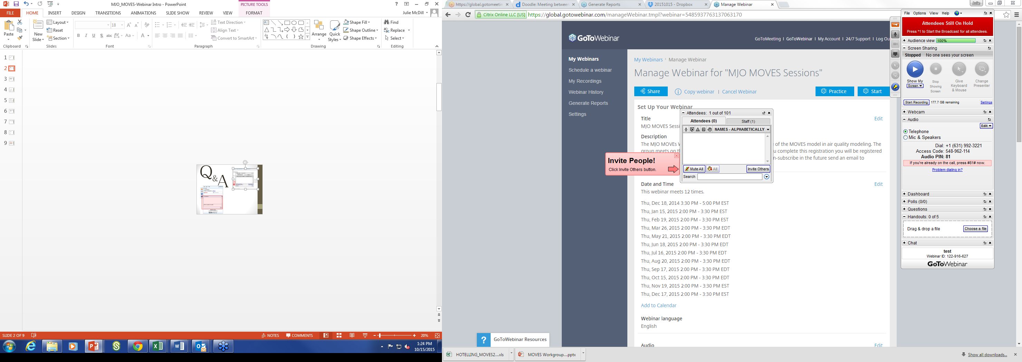
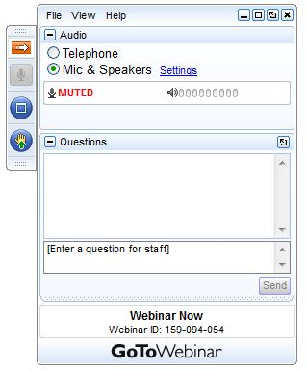

Q
&
A
Notes:
We welcome any questions you may have. There are a few ways in which you can communicate with us and ask questions during the presentation:
ADVANCE SLIDE>>
FIRST, please use the QUESTIONS box on your control panel to type in your questions regarding content at any time during the presentation. There will be time for Q&A in the middle and at the end of the presentation. If there is more than one person participating via your connection, please take a moment to provide us with their names and a head count using the QUESTIONS box.
ADVANCE SLIDE>>
SECONDLY, the CHAT box feature should be used for comments and/or technical issues only - NOT for questions
Following today’s presentation, there will be a link to an on-line survey that we encourage you to complete.
Phone lines will be muted for the presentation. Susan, we will now share your screen
CLICK SHARE SCREEN AND MAKE Susan A PRESENTER>>

Slide 3
Overview
About R
R for Data Science
Packages
Graphics
ggplot2
openair
console vs. editor
run some code ☺
Basics
Why do we need Tidy Data? What is Tidy Data?
Pros and Cons—R vs. Excel
Coding basics
Storing variables, temporary objects
Data types
Data structures
Missing values
Object names
Functions
Logical operators
Calling columns in a data frame with $
RMarkdown
Collaboration best practices
Working directories and project-oriented workflow
R Projects instead of setwd()
Importing data

Slide 4

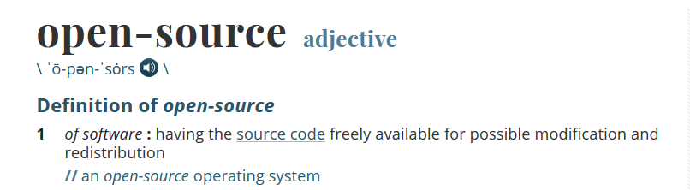
About R
Statistical programming language
High-level
Versatile, robust
Packages
Useful for both data preparation and data analysis
Merriam Webster

Slide 5
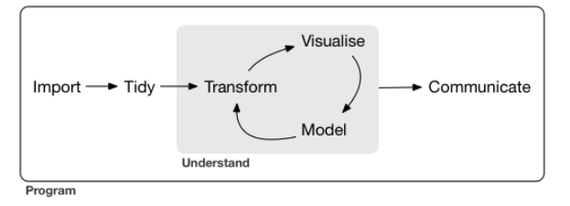
R for Data Science by Garrett Grolemund and Hadley Wickham
Free, online book (also available in print)
Much of this training is based on this book. Relevant chapters are linked in slide titles where appropriate.
Grolemund and Wickham outline steps involved in a data science project using this graphic:
Grolemund and Wickham

Slide 6
Packages
Contain numerous functions that help you complete specialized tasks
Anyone can make one
The reason R is so versatile and robust
Tidyverse
Openair
Many, many more

Slide 7
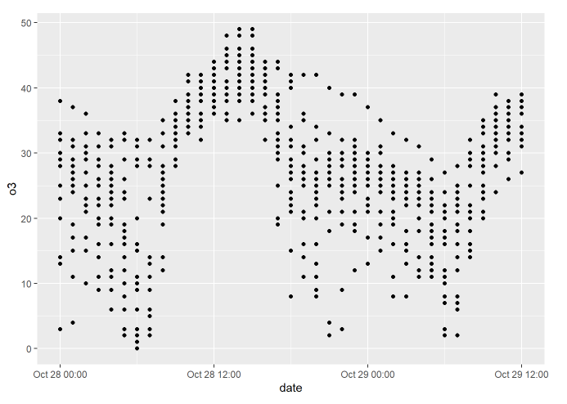
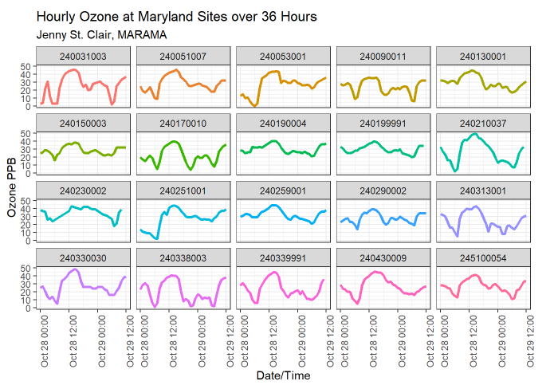
Graphics—ggplot2
Simple/exploratory
Advanced/presentation-ready

Slide 8
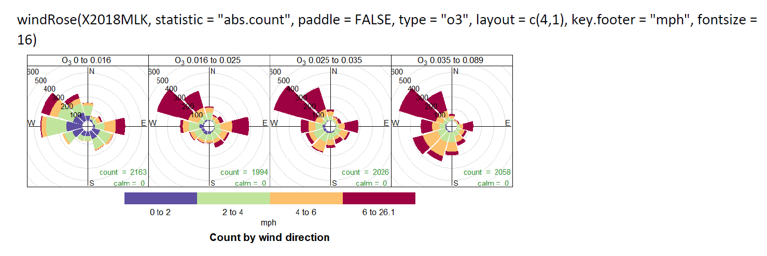
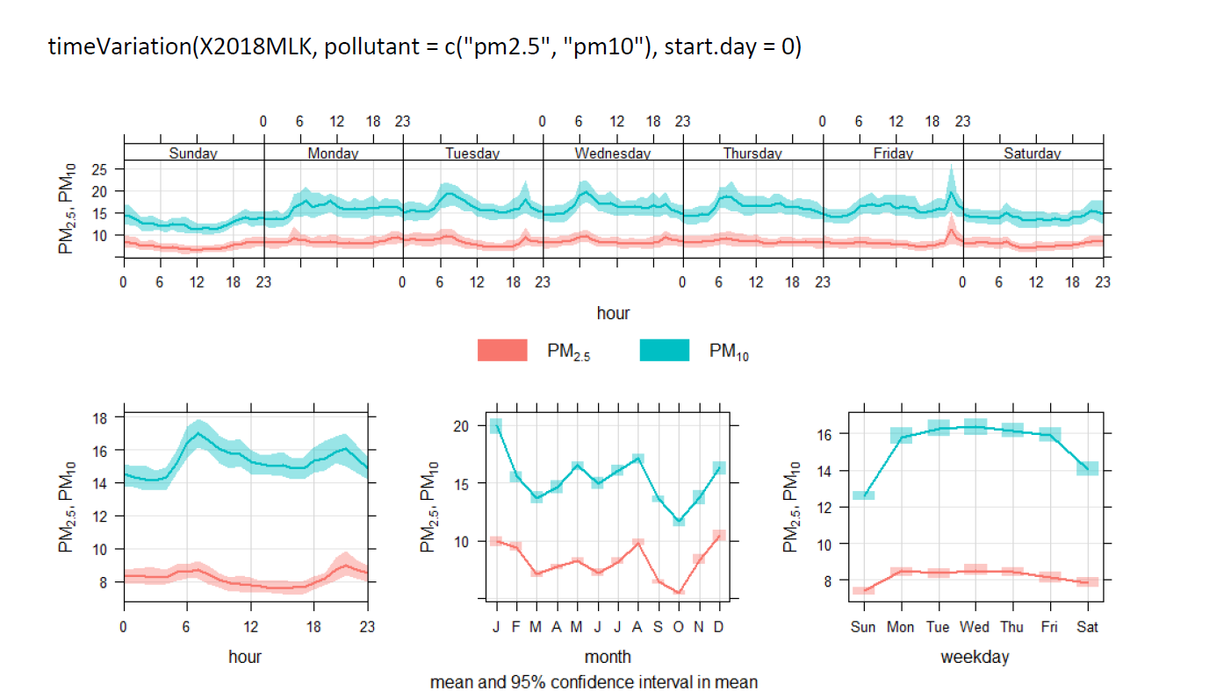
Graphics—openair
Thank you to Keith Hoffman!

Slide 9
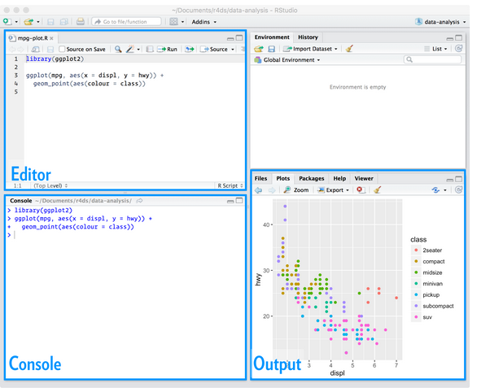
Workflow: console vs. editor
You can run code in the console or the editor. It’s a great place to experiment with unfamiliar functions.
To run in the console, type your code and press enter
If you want to save your code, use the editor. When you save code in the editor, it’s called a script.
The editor in R will run one line at a time, so place your cursor on the line you want to run. Press ctrl +enter (cmd + enter on a mac).
Or, highlight a few lines of code and press ctrl + enter
Grolemund and Wickham

Slide 10
1. Double click on the R Project file in the Webinar 1 materials folder. 2. Then, in the training materials folder, open the file “graphics.html”

Slide 11
5 Minute Break

Slide 12
Why do we need Tidy Data?
Data explosion in the last ~30 years
Collect it and we’ll figure it out later…
As a result, we now have an abundance of data, but the majority of it is messy, and in a variety of different formats
We need a systematic, repeatable, and transparent way to tidy data
That is why the tidyverse was created!

Slide 13
Terminology—just to be precise
We are all familiar with these terms, but just so we are precise with definitions (these definitions come from R for Data Science, linked above).
A variable is a quantity, quality, or property that you can measure.
A value is the state of a variable when you measure it.
An observation is a set of measurements made under similar conditions (you usually make all of the measurements in an observation at the same time and on the same object).

Slide 14
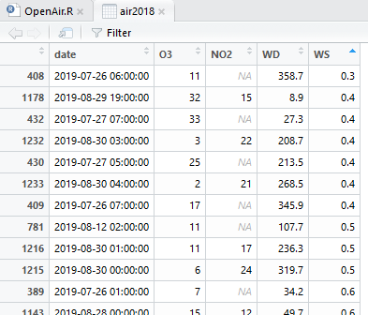
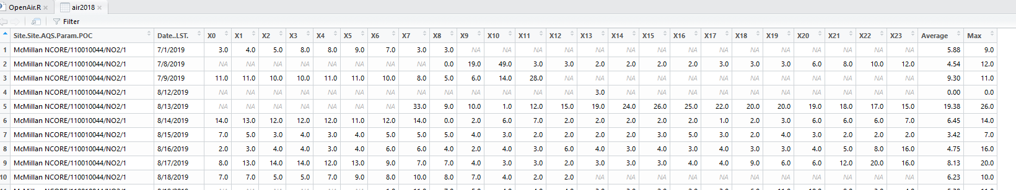
Principles of tidy data
Tidy:
Every column is a variable
Every row is an observation
Every cell is a single value
Messy:

Slide 15
Pros of using R instead of Excel
Many reasons:
Excel crashes when you open a large file, R is more capable of handling bigger data
Excel is a spreadsheet tool. It’s easy for human errors to hide in a spreadsheet, and harder for them to hide in a script.
R can be used for more advanced statistics.
R allows you to communicate your entire methodology.
R enables you to create highly customizable graphics to display your data.

Slide 16
Cons of using R instead of Excel
Steep learning curve. Time is money.
Many colleagues do not know R, may hinder collaboration

Slide 17
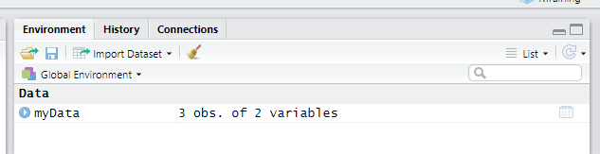
Coding basics (R for Data Science)
You can use R as a calculator
400 * 3 + 55.889
2 ^ 8
You can create new objects with <- (which reads “gets”)
objectName <- value
someText <- “Hello World”
print(someText)
Give your objects short and meaningful names.
You can see all the objects you’ve created in the upper righthand side of your RStudio window—or the Environment
You can make a line into a comment by typing # in front. This is how you can add plain text or non-executable code.
Tip: press alt + shift + k and see what happens

Slide 18
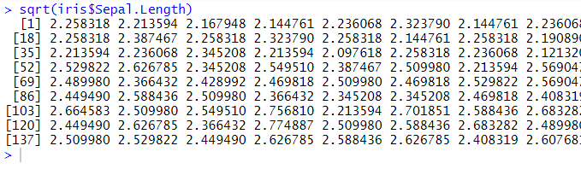
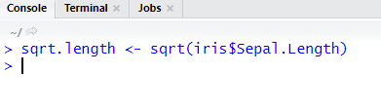
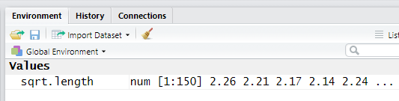
Storing variables, temporary objects
When you run functions in R, you have two options for handling the output:
Allow it to print to the console (it’s not saved and you can’t use it later)
Store it in an object using <- “gets”

Slide 19
Data types
Character “Hello World”
Numeric (real or decimal) 3.14159
Integer 7
Logical TRUE

Slide 20
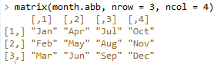
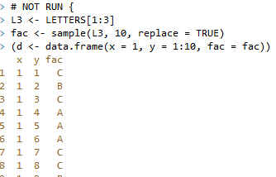
Data structures
Atomic vector
The most basic data structure
c(1, 4, 6, 2, 3)
c(“hello”, “world”, “its”, “me”, “jenny”)
List
Similar to a vector, but it can store different data types
list(1, “hello”, TRUE, 3.141)
Matrix
The simplest 2-dimensional data structure
Data frame
Similar to matrices, tightly couples collections of variables
Factors
A vector with ordered levels
Extremely helpful with categorical data

Slide 21
Missing values
Represented by:
NA
Because R is a statistical language it knows what a missing value is (when it’s represented with NA)
If you want R to automatically recognize something as a missing value, set the value to NA
Sometimes happen when an operation doesn’t make sense (often due to problems with data types)

Slide 22
Object names
Must start with a letter
Can contain _ and .
Descriptive
Some people use snake_case, others prefer camelCase.
Best practice: be consistent with your naming conventions.

Slide 23
Functions
R has many functions built in. These are referred to as Base R functions.
When you call a function, it looks like this:
function_name( arg1 = val1, arg2 = val2)
You can create a function, but that’s beyond the scope of our training.
You will see many examples of functions as we move forward.

Slide 24
Logical operators
You will need to use logical operators when sub-setting data and in if-statements when your scripts get more complex (we will not cover if-statements in this training)
“not” = !
“and” for vectors > length-1 = &
“and” for single, scalar objects = &&
“or” for vectors > length-1 = |
“or” for single, scalar objects = ||
exclusive “or” = xor(x, y)
isNA() checks if an object is NA and returns TRUE or FALSE

Slide 25
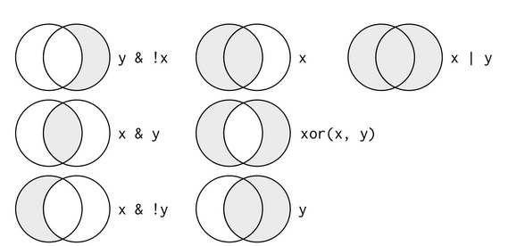
Logical operators

Slide 26
Logical operators: examples
month == 11 | month == 12
Returns observations where month is either November OR December (inclusive or)
month >= 3 & month <= 6
Returns observations where month is between March and June (inclusive of March and June)

Slide 27
Calling columns in a data frame with $
The most commonly used practice to identify a single column in a data frame looks like this:
myData$columnName

Slide 28
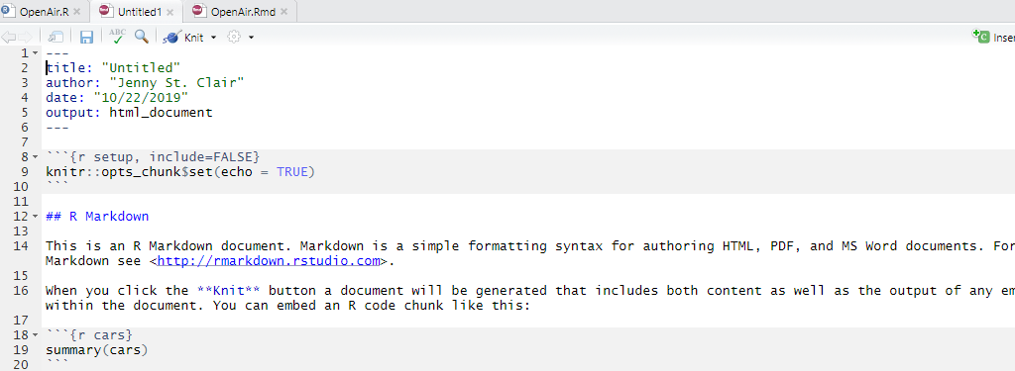
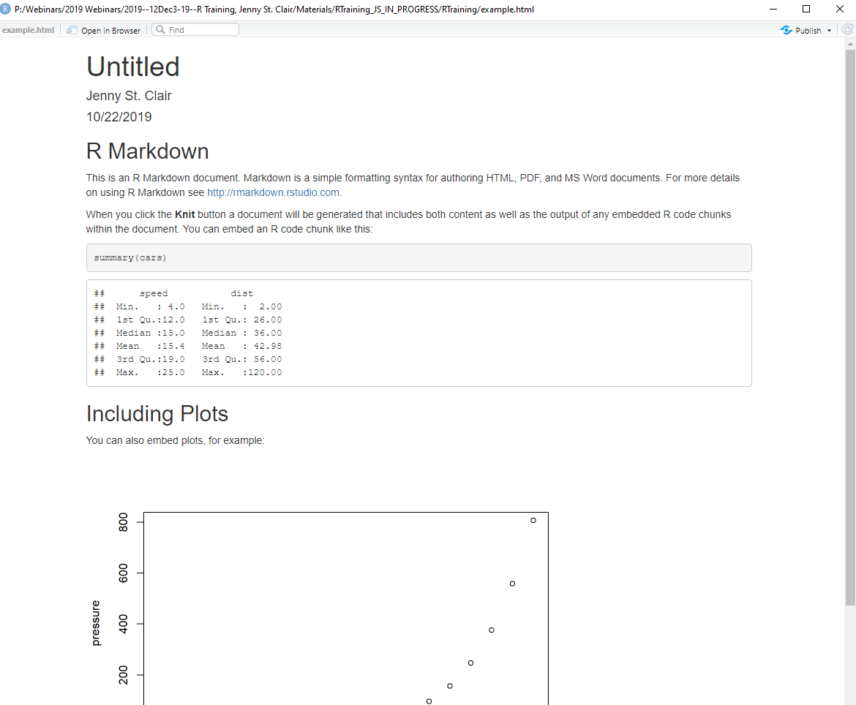
RMarkdown
1. Open a new .Rmd file
File > New File > R Markdown
2. Write document by editing template
3. Knit document to create report
Use knit button or render()
More instructions here: https://rstudio.com/wp-content/uploads/2016/03/rmarkdown-cheatsheet-2.0.pdf
and here: https://holtzy.github.io/Pimp-my-rmd/

Slide 29
Sharing code
“Any fool can write code that a computer can understand. Good programmers write code that humans can understand.” - Martin Fowler, Refactoring: Improving the Design of Existing Code, 1999
Best practices—writing code for humans

Slide 30
Sharing code
Be sure that your code
Is well-spaced
# Has comments that tell colleagues what the code does (when necessary)
Would run on someone else’s computer without clearing their environment (do not use rm(list = ls()) in a shared script), or installing packages (if you include install.packages(), comment it out using #)

Slide 31
What is a working directory?
When you import data from your computer, you have to tell R where to look for the file.
You can set a working directory so that R will know where to look.
Many people use the command setwd() for this. works, but will cause you many headaches when collaborating with people, sharing your work online, or even later on in your workflow if you move things around on your computer.
Fortunately, there’s a better way… R Projects!
This brings us to project-oriented workflow
Also helpful: the here package https://github.com/jennybc/here_here#readme

Slide 32
Project-oriented workflow: three main rules
Keep ALL relevant data and scripts in one main project folder (sub-folders okay).
This folder cannot be Documents, Desktop, Downloads, or any main folder on your computer. It is just for the project.
Create an R Project in this folder.
Do not start your script with setwd(). Instead, start with here::here() which will print the location which you’re working from to verify that you’re in the right place.
Side note: the double colon :: tells you that you are calling the function (on the right) from the package (on the left). As long as you have the package installed (remember, install.packages()), you can use this to employ a function from a package without loading (library()) the entire package.

Slide 33
Sharing code—Use R Projects instead of setwd()
In the RStudio window, click “File”
On the drop down menu, click “New Project”
A new window will pop up. If you are beginning a new project, click “New Directory.”
Save your project to a folder on your computer that you will ONLY use for this project. Save all data and code associated with this project in this folder.
Using an RMarkdown file accomplishes the same task—Shane will talk more about this

Slide 34
Sharing code—Use R Projects instead of setwd()
Now, you don’t need to call a working directory to run the code.
To return to your project, open RStudio by double clicking on the project in your chosen folder. Now open your script by clicking “File” and then “Open file.”
You are automatically using your project folder as a working directory.
If you share your project folder, it can easily be run on anyone’s computer without changing working directories.

Slide 35
Other best practices
Restart R in between projects.
Do not save your workspace. Start fresh every time. Change Global Options so that RStudio will stop prompting you to save your workspace.
Save important files and graphics explicitly in your code (not just by clicking in the IDE).
rm(list = ls()) don’t put this unfriendly line of code in your script! Start fresh by restarting RStudio.
See this book for more.

Slide 36
Importing data
CSV’s are the best file format
Other delimited files are fine too
excel workbook files can import but will complicate things
Two most commonly used functions:
read_csv() tidyverse (readr)
read.csv() base R
Very similar. I use read.csv(), Shane uses read_csv()
Syntax:
data <- read.csv(“fileName.csv”)
data <- read_csv(“fileName.csv”)
Paths to these files is necessary if you are not already pointed to your working directory (more on this later!)
Many other arguments are available to specify things like whether there is a header, or if the delimiter is something other than a comma
https://readr.tidyverse.org/reference/read_delim.html
http://rprogramming.net/read-csv-in-r/

Slide 37
Questions?

Slide 38
MARAMA Training Events
UPCOMING TRAINING COURSES
WEBINAR: Air Pollution Meteorology & Modeling for Beginners presented by Tony Sadar, ACHD, February 5 and 12, 2020
APTI 418 Control of Nitrogen Oxide Emissions: March 3-5, 2020, Richmond, VA (Registration opening soon)
MARAMA Air Permits Training Workshop: March 17-19, 2020, Richmond, VA (Registration opening soon)
APTI 452 Principles and Practices of Air Pollution: March 24-26, 2020, Harrisburg, PA (Registration opening soon)
R for Air Quality Applications: April, 2020
Visit MARAMA’s website for more information:
http://www.marama.org/training-center/event-schedule
Notes:
Review upcoming courses and workshops.
ADVANCE SLIDE>>

Slide 39
Last Words
Webinar On-Line Evaluation and Post Test
Please complete a brief, on-line Evaluation Survey, which will be forwarded to you via email following this webinar along with your Certificate of Participation.
Questions?
Please contact Jenny St. Clair
Notes:
Thank you for participating in today’s webinar. After the webinar you will receive an email directing you to a post-webinar evaluation survey and post-test which are required to receive a Certificate of Participation. Please take a few moments to complete the evaluation. Your feedback is very important to us, as we continue to hold webinars in the future and want to make sure we continue to improve. Whether the feedback is positive or negative, please include specifics.
Should you have any questions following the webinar, we have included our contact information for your convenience.

Slide 40
Thank you!!

